Slide 1
Lecture 3
Permutations and combinations

Slide 2
Summary
Addition and multiplication principle
Permutations of sets
Combinations of sets
Permutations of multi-sets
Combinations of multi-sets

Slide 3
Addition and multiplication principles
Let m be the number of ways to do task 1 and n the number of ways to do task 2 (with each number independent of how the other task is done), and assume that no way to do task 1 simultaneously also accomplishes task 2.
The addition principle: The task “do either task 1 or task 2, but not both” can be done in m+n ways.
The multiplication principle: The task “do both task 1 and task 2” can be done in mn ways.

Slide 4
Set Theoretic Version
If A is the set of ways to do task 1, and B the set of ways to do task 2, and if A and B are disjoint, then:
The ways to do either task 1 or 2 are A∪B, and |A∪B|=|A|+|B|
The ways to do both task 1 and 2 can be represented as A×B, and |A×B|=|A|·|B|

Slide 5
Examples
A student wishes to take either a mathematical course or a biology course, but not both. If there are 4 mathematics and 3 biology courses for which the student has the necessary prerequisites, then the student can choose a course to take in 4+3=7 ways.
A student is to take two courses. The first meets at any one of 3 hours in the morning and the second at any one of 4 hours in the afternoon. The number of schedules that are possible for the student is 3x4=12.

Slide 6
Example
Determine the number of positive integers which are factors of the number 3⁴ ×5² ×11⁷ ×13⁸
Answer: The number 3, 5, 11, 13 are prime numbers. Hence the factor is of the form
3^{i} ×5^{j} ×11^{k} ×13^{l}
where 0≤i≤4, 0≤j≤2, 0≤k≤7, and 0≤l≤8.
There are 5 choices for i, 3 for j, 8 for k, and 9 for l. By the multiplication principle, the number of the factors is 5x3x8x9 = 1080.

Slide 7
Exercises
How many two-digit numbers have distinct and non-zero digits?
How many odd numbers between 1000 and 9999 have distinct digits?
How many integers between 0 and 10000 have exactly one digit equal to 5?
How many different five-digit numbers can be constructed out of the digits 1, 1, 1, 3, 8?

Slide 8
Hints
9 × 8
5 ×8 × 8 × 7
Regard the number as a 4-digit number.
9 ×9 ×9 ×4
5 × 4

Slide 9
Permutations of sets
A permutation of a set S of objects is a sequence containing each object once.
An ordered arrangement of r distinct elements of S is called an r-permutation.
The number of r-permutations of a set with n=|S| elements is
P(n,r) = n(n−1)…(n−r+1) = n!/(n−r)!
If r > n, then P(n,r) = 0. P(n,1) = n for each positive integer n.

Slide 10
Permutation Example
A terrorist has planted an armed nuclear bomb in Paris, and it is your job to disable it by cutting wires to the trigger device. There are 10 wires to the device. If you cut exactly the right three wires, in exactly the right order, you will disable the bomb, otherwise it will explode! If the wires all look the same, what are your chances of survival?
P(10,3) = 10·9·8 = 720,
so there is a 1 in 720 chance that you’ll survive!

Slide 11
Exercises
The number of 4-letter “words” that can be formed by using each of the letters a, b, c, d, e at most once equals P(5, 4) = 5!/(5-4)! =120.
What is the number of ways to order the 26 letters of the alphabet so that no two of the vowels a, e, i, o and u occurs consecutively?
How many 7-digit numbers are there such that the digits are distinct integers taken from {1, 2, …, 9} and such that the digits 5 and 6 do not appear consecutively in either order?

Slide 12
Hints
21! × P(22, 5)
3.
(a) neither 5 nor 6 appears
      P(7,7)
(b) either 5 or 6 appears
      2×7×P(7,6)
(c) both 5 and 6 appear
      P(7,5) ×P(6,2)

Slide 13
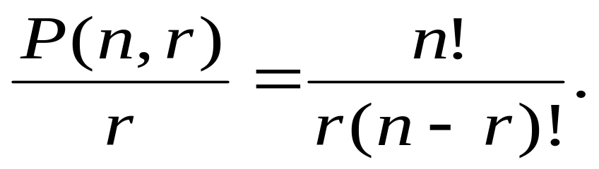
Circular permutations
The permutations that arrange objects in a line are called linear permutations. If the objects are arranged in a cycle, the permutations are called circular permutations.
The number of circular r-permutations of a set of n elements is given by
In particular, the number of circular permutations of n elements is (n - 1)!.

Slide 14
Examples
Ten people, including two who do not wish to sit next to one another, are to be seated at a round table. How many circular seating arrangements are there?
What is the number of necklaces that can be made from 20 beads, each of a different color?

Slide 15
Hints
8! ×7
19!/2
1
1
2
2
5
5
3
3
4
4

Slide 16
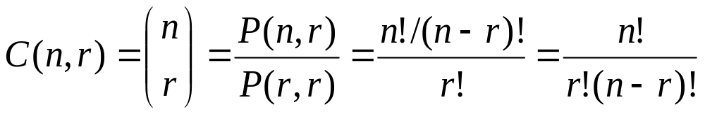
Combinations of sets
An r-combination of elements of a set S is simply a subset T⊆S with r members, |T|=r.
The number of r-combinations of a set with n=|S| elements is
Note that C(n,r) = C(n, n−r)
  Because choosing the r members of T is the same thing as choosing the n−r non-members of T.

Slide 17
Combination Example
25 points, no 3 collinear, are given in the plane. How many straight lines do they determine? How many triangles do they determine?
C(25, 2); C(25, 3)
How many 8-letter words can be constructed by using the 26 letters of the alphabet if each word contains 3, 4, or 5 vowels? There is no restriction on the number of times a letter can be used in a word.

Slide 18
Hints
Case a. 3 vowels:
  C(8, 3) ×5³×21⁵
Case b. 4 vowels:
  C(8, 4) ×5⁴×21⁴
Case c. 5 vowels:
  C(8, 5) ×5⁵×21³
Answer: C(8, 3) ×5³×21⁵+ C(8, 4) ×5⁴×21⁴+ C(8, 5) ×5⁵×21³

Slide 19
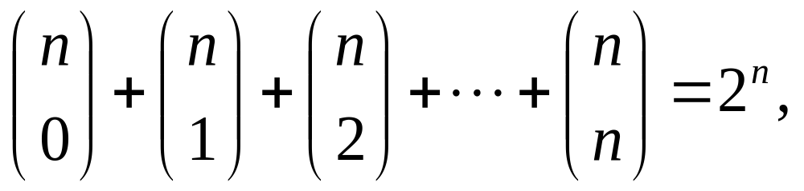
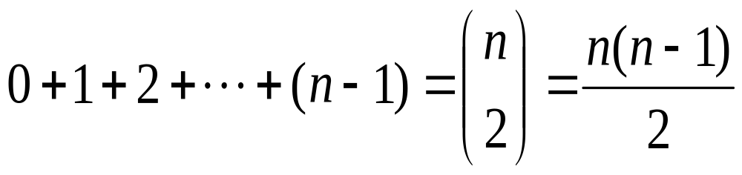
and the common value equals the number of combinations of an n-element set.
Consider the 2-combinations of the set {1,2,…,n}. Partition the 2-combinations according to the largest integer they contain. For each i = 1, 2, …, n, the number of 2-combinations in which i is the largest integer is i – 1. Equating the two counts we obtain

Slide 20
Permutations of multi-sets
If S is a multiset, an r-permutation of S is an ordered arrangement of r of the objects of S. If |S| =n, then an n-permutation of S will also be called a permutation of S.
Let S be a multiset with objects of k different types where each has an infinite repetition number. Then the number of r-permutations of S is k^{r}.

Slide 21
Examples
What is the number of ternary numerals with at most 4 digits?
Answer: It is the number of 4-permutations of the multiset with three types {0}, {1}, {2}. Hence the number is 3⁴ = 81.

Slide 22
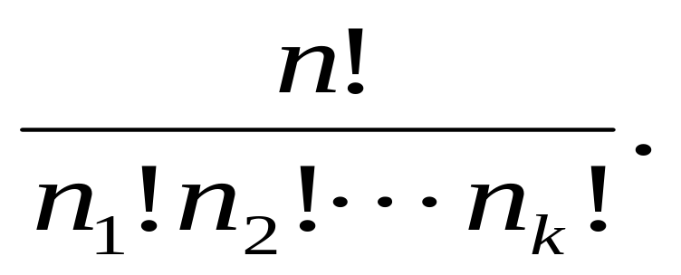
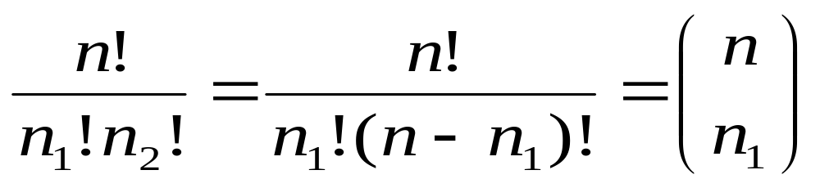
Finite Repetition Numbers
Let S be a multiset with objects of k different types with finite repetition numbers n₁, n₂, …, n_{k}, respectively. Let the size of S be n = n₁+ n₂+ …+ n_{k}. Then the number of permutations of S equals
Specially, when k=2

Slide 23
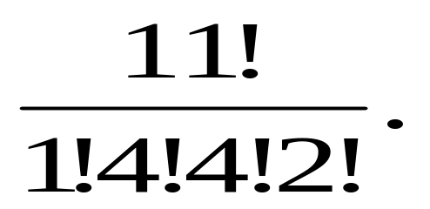
Examples
The number of permutations of the letters in the word MISSISSIPPI is
How many possibilities are there for 8 non-attacking rooks on an 8-by-8 chessboard? (1) The rooks are indistinguishable for one another; (2) we have 8 distinguished rooks; (3) we have 1 red rook, 3 blue rooks and 4 yellow rooks.

Slide 24
Hints
The coordinates for the 8 rooks are (1, j₁), (2, j₂), …, (8, j₈), respectively.
(1) we have a 1-to-1 correspondence between sets of 8 non-attacking rooks and permutations of {1, 2, …, 8}. 8!
(2) Based on (1), decide which permutation of the 8 colors 8! ×8！
(3) based on (1), we decide a permutation of colors of the multiset 8!×8!/1!3!4!

Slide 25
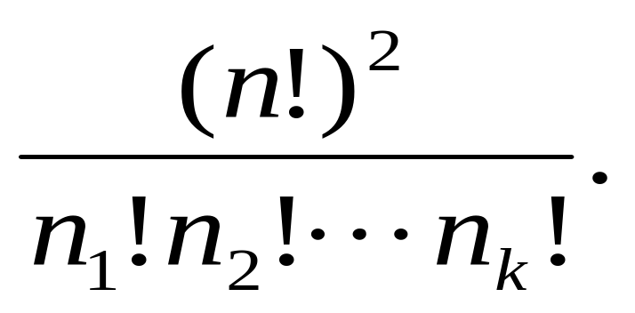
Chessboard Problem
There are n rooks of k colors with n₁ rooks of the first color, n₂ rooks of the second color, ……., and n_{k} rooks of the kth color. The number of ways to arrange these rooks on an n-by-n board so that no rook can attack another equals

Slide 26
Example and Exercise
Consider the multiset S = {3{a}, 2{b}, 4{c}} of 9 objects of 3 types. Find the number of 8-permutations of S.
(8!/2!2!4!)+(8!/3!1!4!)+(8!/3!2!3!)
Determine the number of 10-permutations of the multiset S = {3{a}, 4{b}, 5{c}}.

Slide 27
Combinations of Multisets
If S is a multiset, then an r-combination of S is an unordered selection of r of the objects of S. Thus an r-combination is itself a multiset, a submultiset of S.
Example. If S = {2{a}, 1{b}, 3{c}}, then the 3-combinations of S are {2{a}, 1{b}}, {2.a, 1.c}, {1.a, 1.b, 1.c}, {1.a, 2.c}, {1.b,2.c}, {3.c}.

Slide 28
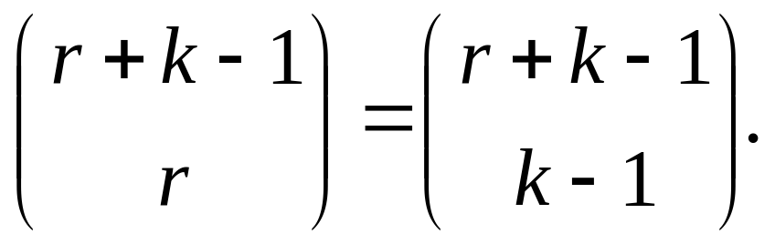
r-combinations
Let S be a multiset with objects of k different types where each has an infinite repetition number. Then the number of r-combinations of S equals

Slide 29
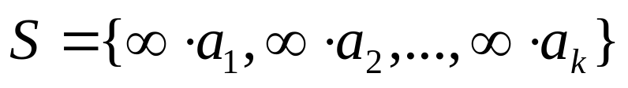

Outline of Proof
Let
Any r-combination of S corresponds to a non-negative integer solution of the equation x₁ + x₂ + … + x_{k} = r and vice versa.
The number of these solutions equals the number of permutations of the multiset

Slide 30
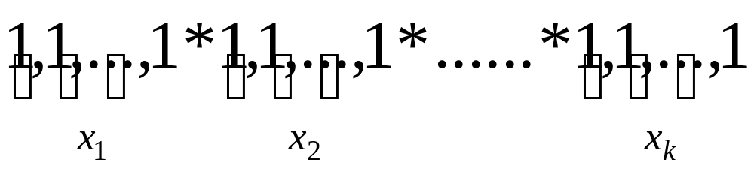
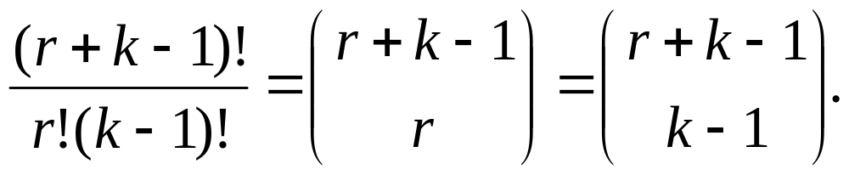
Outline of Proof

Slide 31
Examples
A bakery boasts 8 varieties of doughnuts. If a box of doughnuts contains 1 dozen how many different boxes can you buy?
What is the number of non-decreasing sequences of length r whose terms are taken from 1,2,…,k?
Let S be the multiset {10.a, 10.b,10.c,10.d} with objects of four types, a, b, c and d. What is the number of 10-combinations of S which have the property that each of the four types of objects occurs at least once?

Slide 32
Hints
C(12+8-1,12)
C(r+k-1,r)
The number of positive integral solutions of x₁+x₂+x₃+x₄=10
Let y₁=x₁-1, y₂=x₂-1, y₃ = x₃-1, y₄=x₄-1.
Non-negative solutions of the equation y₁+y₂+y₃+y₄ =6
The combinational meaning of the equation.
C(6+4-1, 6)

Slide 33
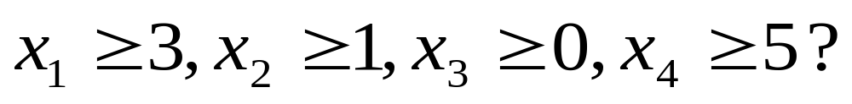
Exercise
What is the number of integral solutions of the equation x₁+x₂+x₃+x₄=20 in which
Let y₁ = x₁ -3, y₂ = x₂-1, y₃ = x₃, y₄ = x₄-5 .
Then y_{i} ≥ 0, the equality is equivalent to
y₁ + y₂ + y₃ +y₄ = 11

Slide 34
Comments
The number of r-combinations of a multiset S equals to the number of non-negative integer solutions of the equation
x₁ + x₂ +x₃ +…+x_{k} = r.
In the case the repetition number is limited in a multiset, the problem is more complex and difficult. That will be introduced in Chapter 6.

Slide 35
Assignments
4(a), 7, 19(b), 30, 61

